Slide 1
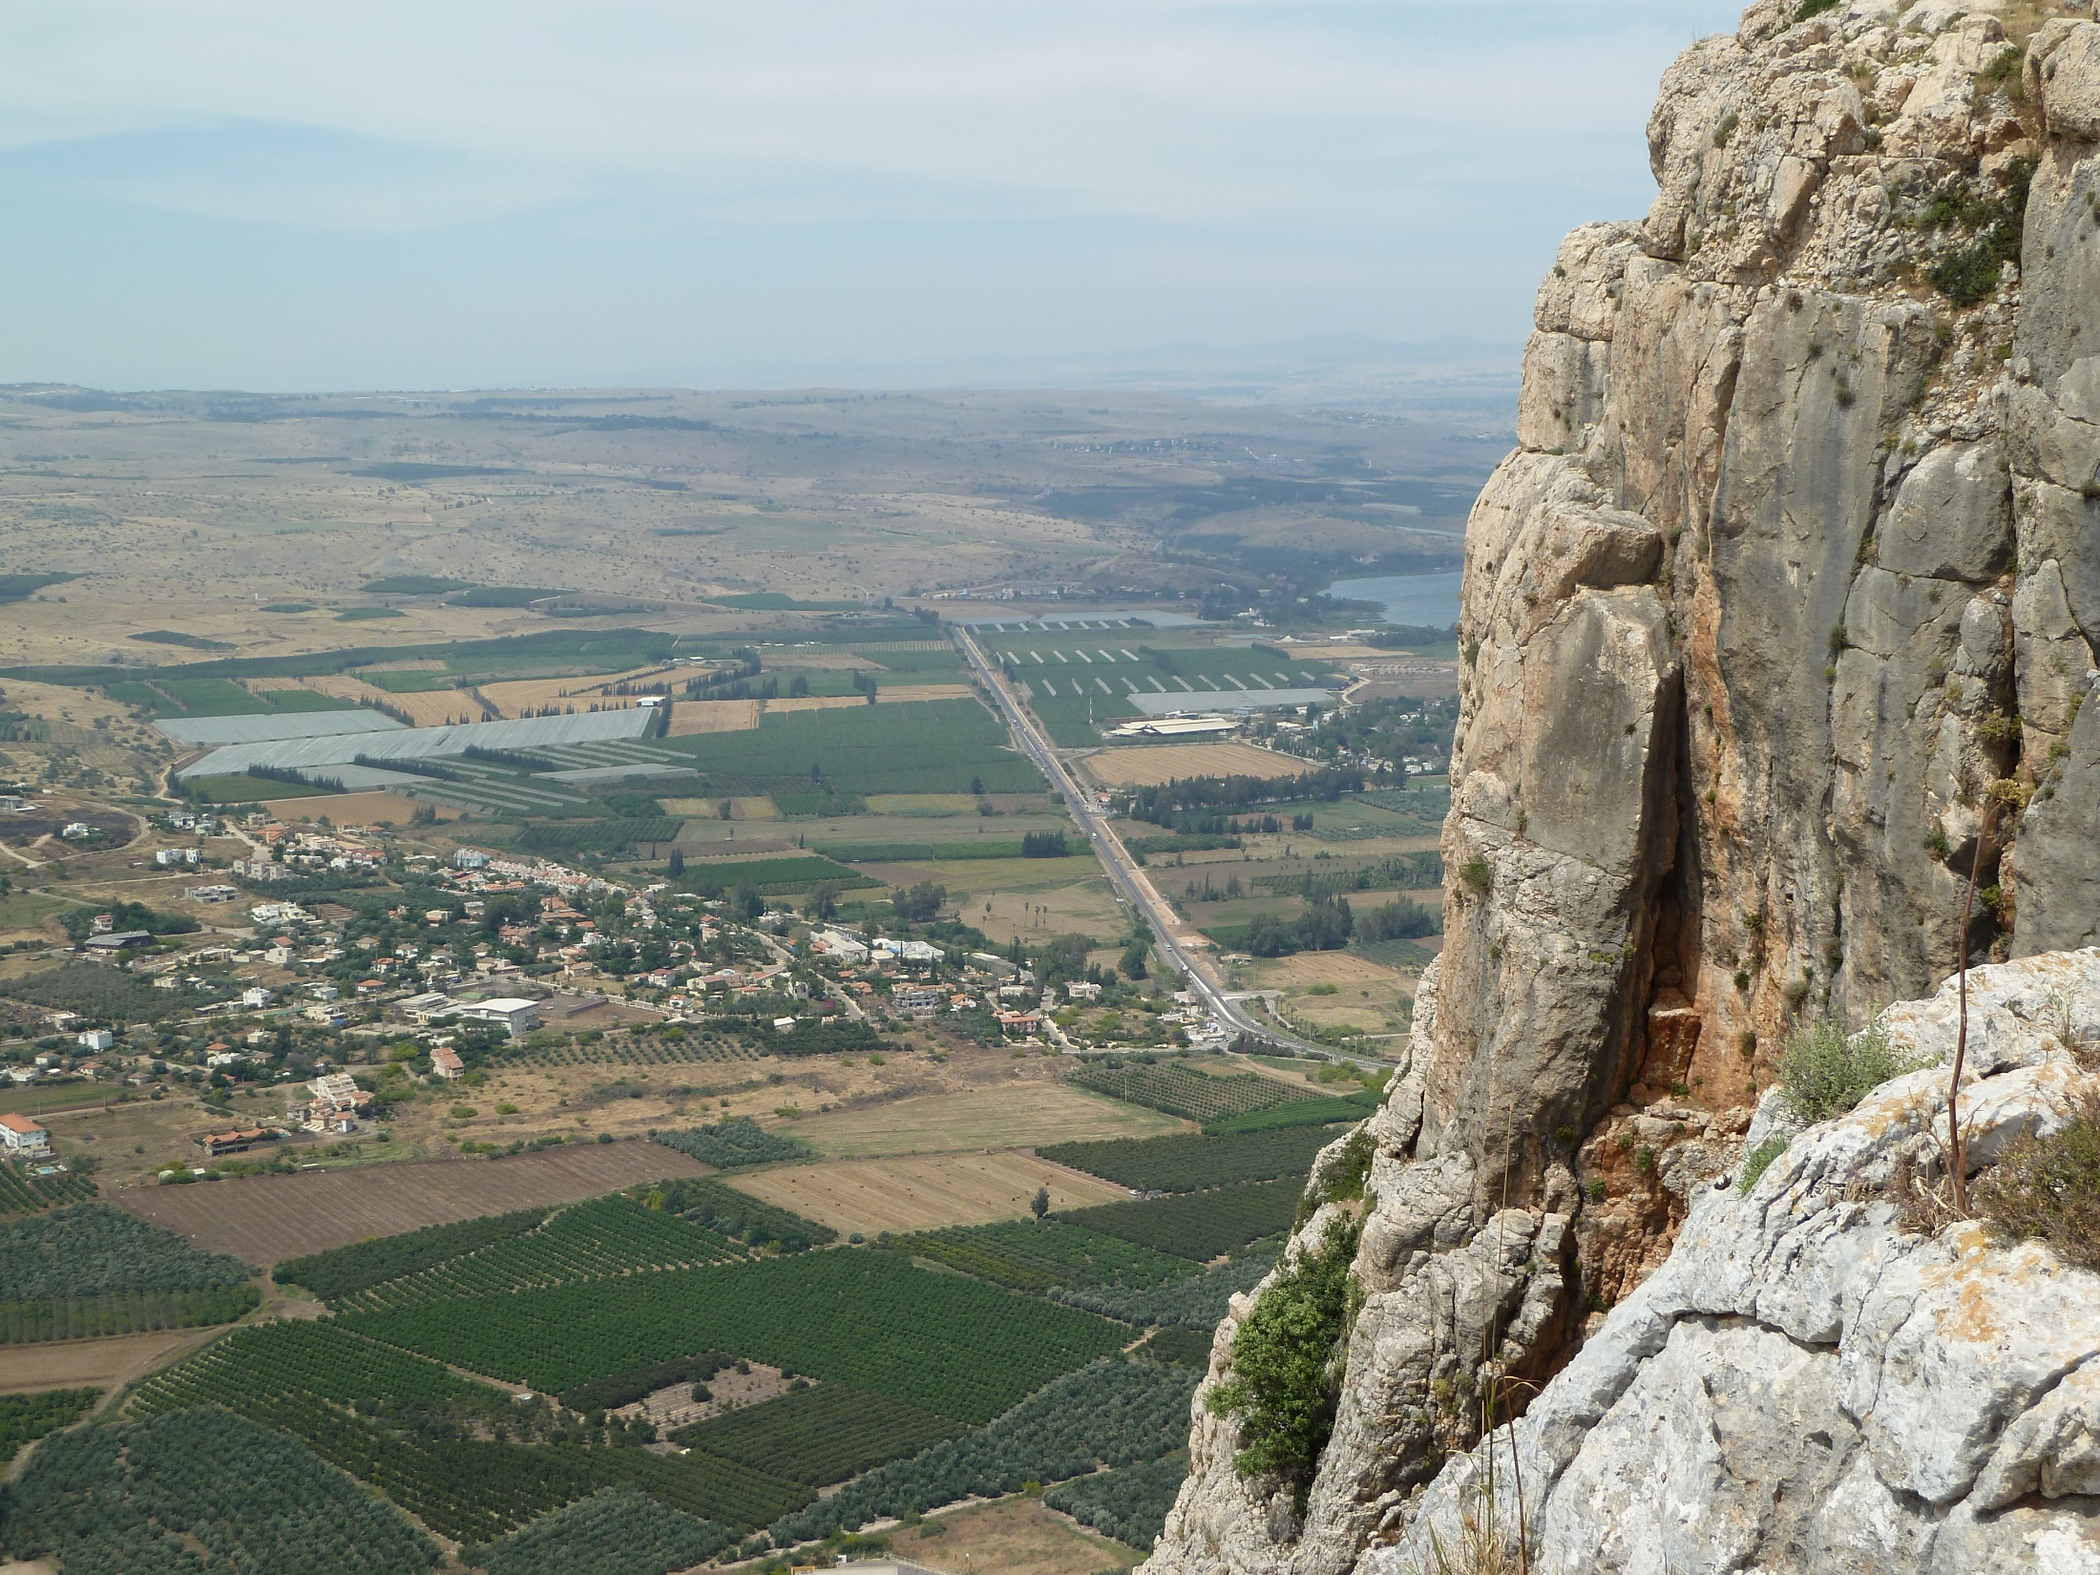
Psalm 11

Slide 2
1 [Introduction] For the Director; according to David.
[David speaks] I have taken refuge in Yahweh.
How can you say to my soul,
“Flee like a bird to a mountain?”
2 [Advisors respond] “Indeed, see!
The wicked are bending the bow.
They have taken aim with their arrow on the bow string,
to shoot in darkness toward the upright of heart.
3 For the foundations are ruined.
What has the righteous person done?”

Slide 3
4 [David responds] Yahweh is in his holy temple.
Yahweh, his throne is in Heaven.
His eyes see, his eyelids examine the sons of mankind.
5 Yahweh examines the righteous and the wicked.
His soul hates the one who loves wrongdoing.
6 May he cause it to rain snares on the wicked!
Fire and brimstone and raging wind
are the portion of their cup.
7 For Yahweh is righteous. He loves righteous deeds.
The upright will see his face.

Slide 4
[David speaks] I have taken refuge in Yahweh.
How can you say to my soul,
“Flee like a bird to a mountain?” “the LORD” in most
English Bibles
[Advisors respond] “Indeed, see!
The wicked are bending the bow.
They have taken aim with their arrow on the bow string,
to shoot in darkness toward the upright of heart.
For the foundations are ruined.
What has the righteous person done?”

Slide 5
[David speaks] I have taken refuge in Yahweh.
How can you say to my soul,
“Flee like a bird to a mountain?”
part of David’s quotation of the advisors
in most English Bibles
[Advisors respond] “Indeed, see!
The wicked are bending the bow.
They have taken aim with their arrow on the bow string,
to shoot in darkness toward the upright of heart.
For the foundations are ruined.
What has the righteous person done?”

Slide 6
Psalms 11.1
[David speaks]
I have taken refuge in Yahweh.
How can you say to my soul,
“Flee like a bird to a mountain?”

Slide 7
Psalms 11.2-3
[Advisors respond]
“Indeed, see!
The wicked are bending the bow.
They have taken aim
with their arrow on the bow string,
to shoot in darkness
toward the upright of heart.
For the foundations are ruined.
What has the righteous person done?”

Slide 8
Psalms 11.4-7
[David responds]
Yahweh is in his holy temple.
Yahweh, his throne is in Heaven.
His eyes see, his eyelids examine the sons of mankind.
Yahweh examines the righteous and the wicked.
His soul hates the one who loves wrongdoing.
May he cause it to rain snares on the wicked!
Fire and brimstone and raging wind
are the portion of their cup.
For Yahweh is righteous. He loves righteous deeds.
The upright will see his face.

Slide 9
Psalms 11.4a-b
[David responds]
Yahweh is in his holy temple.
Yahweh, his throne is in Heaven.

Slide 10
Psalms 11.4c-5
[David responds]
His eyes see, his eyelids examine the sons of mankind.
Yahweh examines the righteous and the wicked.
His soul hates the one who loves wrongdoing.

Slide 11
Psalms 11.6
[David responds]
May he cause it to rain snares on the wicked!
Fire and brimstone and raging wind
are the portion of their cup.

Slide 12
Psalms 11.7
[David responds]
For Yahweh is righteous.
He loves righteous deeds.
The upright will see his face.

Slide 13
Suffering
2 Timothy 3.12 NET:
Now in fact all who want to live godly lives in Christ Jesus will be persecuted.

Slide 14
Mosaic Covenant:
➔Israel was to reflect God’s character and represent God to the nations.
➔The king of Israel was God’s anointed representative over all the world.
➔To be against David was to be against God.
➔David could act for God, so had the right to seek divine punishment on the wicked.
God
Israel
King
Nations

Slide 15
New Covenant:
➔The church is to reflect God’s character and represent God as his ambassadors.
➔Rather than ruling in authority, we exhibit grace and love as we share the gospel to invite people to accept salvation in Christ.
➔While we long for God’s deliverance and his justice when Christ returns, we are to pray for our enemies, not for their destruction.
God
Church
Christ
Peoples

Slide 16
Physical Retreat
➔David’s life shows physical retreat is not always counter to faith and obedience.
➔We do not have the same promises for physical protection as David had.

Slide 17
Wisdom & Revelation
➔When there is no revelation, carefully apply human reasoning.
➔When there is revelation from God, act in faith and obedience to that revelation regardless of human reasoning.

Slide 18
Human Wisdom of Advisors:
The situation is hopeless, so we should flee.
Biblical Wisdom of David:
Trust in God’s promises and character, so stand firm.
God
Spiritual
Blessings
Walk by Revelation
Walk by Human Reasoning
Worldly
Blessings
You

Slide 19
Forms of deliverance
➔God delivers us out of the problem.
➔God delivers us to endure the problem.
➔God delivers us to Heaven.
God
Spiritual
Blessings
Walk by Revelation
Walk by Human Reasoning
Worldly
Blessings
You

Slide 20
Take Refuge in God
➔Turn to God in prayer and depend on him to sustain us, empower us, and grow us stronger through the hardships.

Slide 21
Take Refuge in God
➔Turn to God in prayer and depend on him to sustain us, empower us, and grow us stronger through the hardships.
➔Trust in God’s promises, character, power, and justice.

Slide 22
Take Refuge in God
➔Turn to God in prayer and depend on him to sustain us, empower us, and grow us stronger through the hardships.
➔Trust in God’s promises, character, power, and justice.
➔Obey God’s revelation and serve him even when we are suffering.

Slide 23
Take Refuge in God
➔Turn to God in prayer and depend on him to sustain us, empower us, and grow us stronger through the hardships.
➔Trust in God’s promises, character, power, and justice.
➔Obey God’s revelation and serve him even when we are suffering.
➔ Know justice might be delayed, but even now we can “see God’s face.”

